Slide 1
Video Game Success prediction
Andy Quintuna & Yujun Lu

Slide 2
Goal: predict the game rating based on these features:
maximum score
size
price
Publisher
Rating a game
&
Classify it to success or failure
maximum score
maximum completion time.
amount of gamers
Game leaderboard ratio
percentage of gamers who 100% completed the game
minimum completion time

Slide 3
If the rating of a game is higher than 2.5/5.0, it is a successful game!

Slide 4
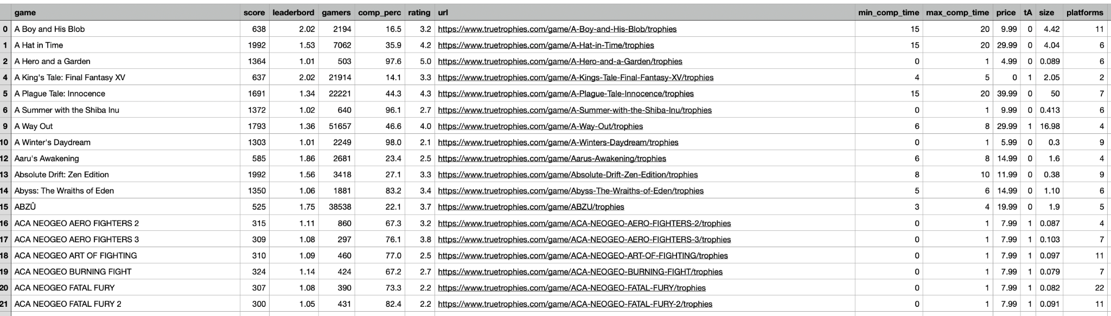
Our dataset

Slide 5
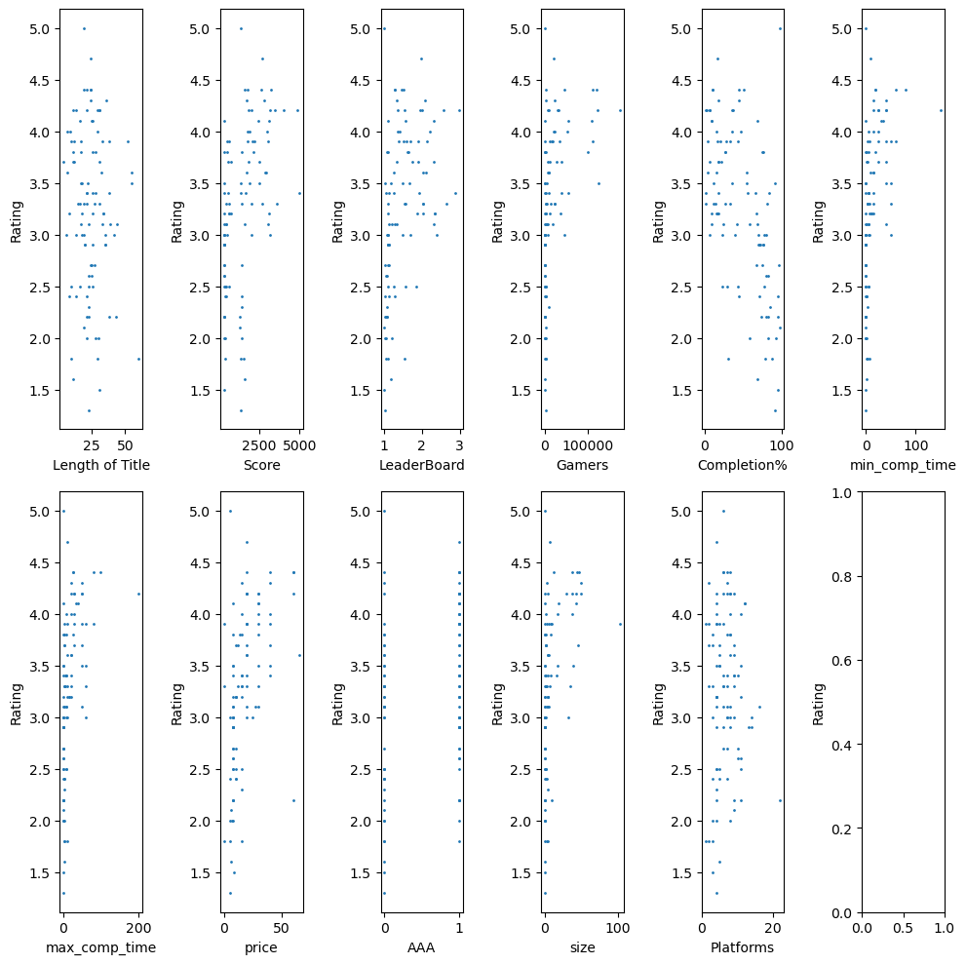

Slide 6
Linear Regression
Transformation: Polynomial Transformation
Training

Slide 7
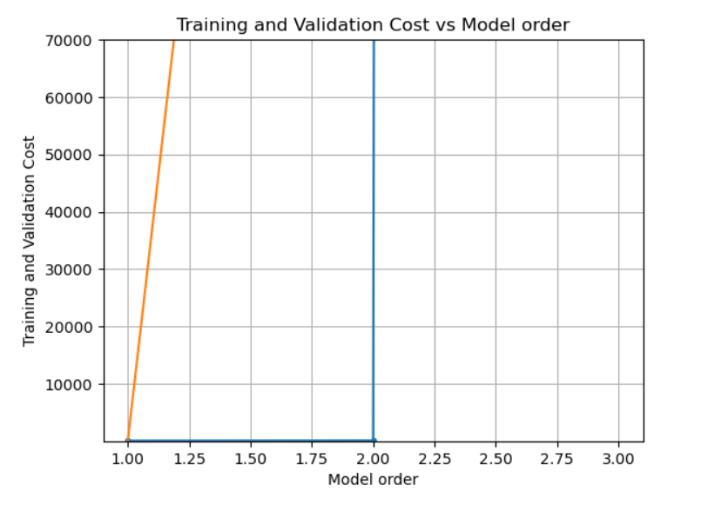
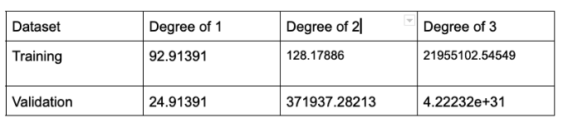
Linear Regression

Slide 8
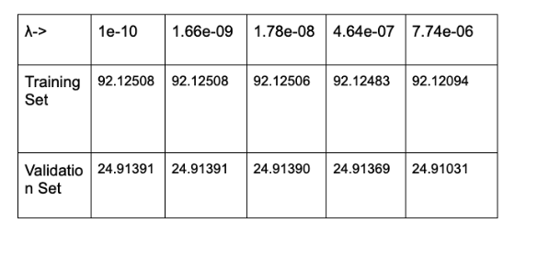
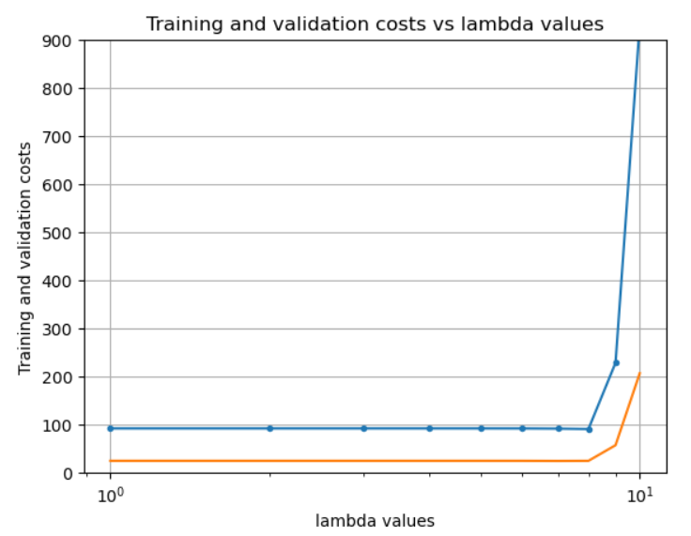
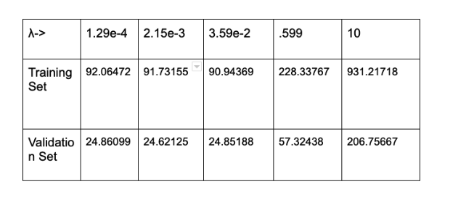
Linear Regression
λ->
1e-10
1.66e-09
1.78e-08
4.64e-07
7.74e-06
Training Set
92.12508
92.12508
92.12506
92.12483
92.12094
Validation Set
24.91391
24.91391
24.91390
24.91369
24.91031
training set: RSS = 32.282295 TSS = 61.717900 R^2 = 0.476938
validation set: RSS = 9.072885 TSS = 14.498000 R^2 = 0.374197

Slide 9
SVM
SVM with 3 different kernels and regularizations:
SVM with linear kernel using L1 regularization
SVM with linear kernel using L2 regularization
SVM with RBF kernel using L2 regularization
SVM with polynomial kernel of degree 2 using L2 regularization
Hyperparameters:
Number of iterations
Different C value

Slide 10
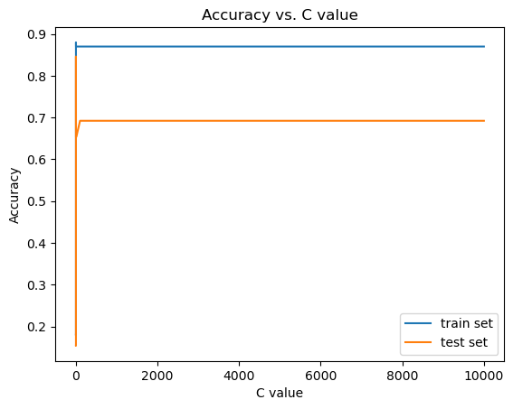
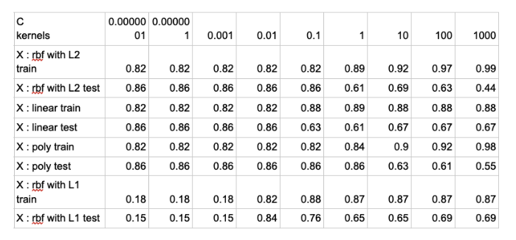
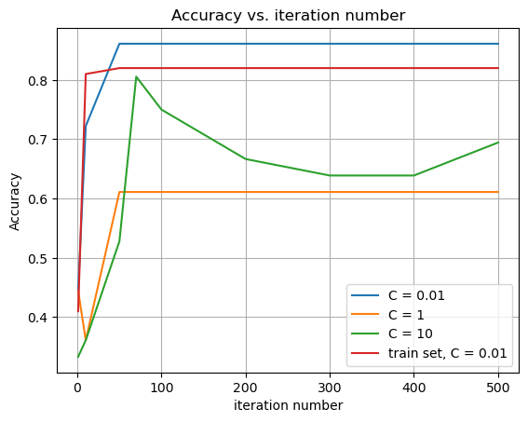
SVM-conclusion
SVM using L1, Linear kernel

Slide 11
Neural Network
Neural Network with 3 different activation functions:
ReLu
Tanh
Logistic
Neural Network with different layers:
2 layers
3 layers
Neural Network with different transformations:
Linear
Polynomial
Hyperparameters:
Number of iterations
Learning rate
Different C value

Slide 12
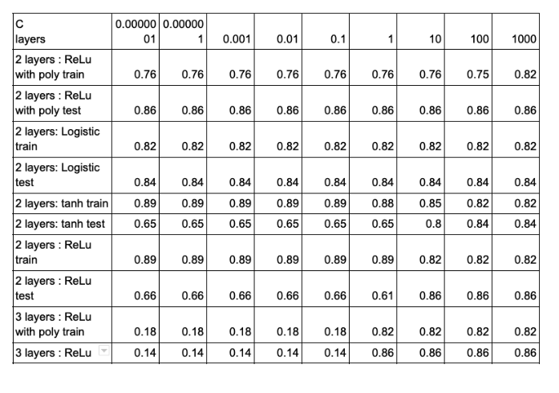
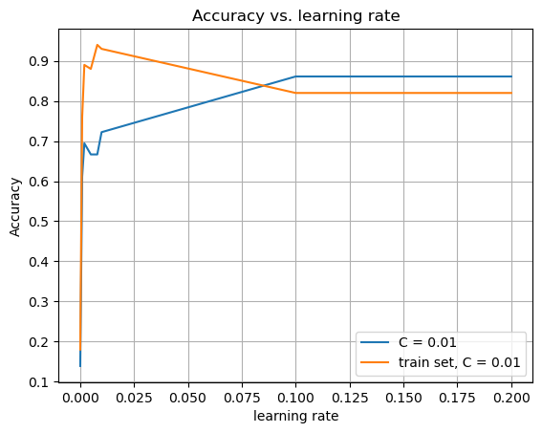
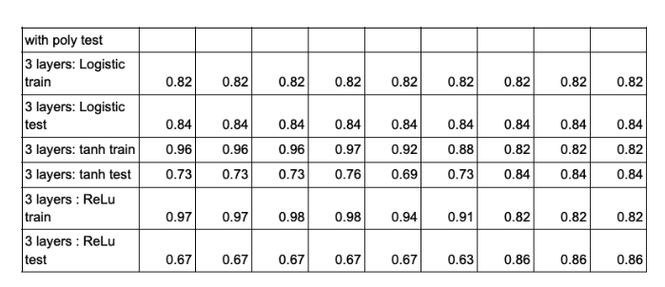
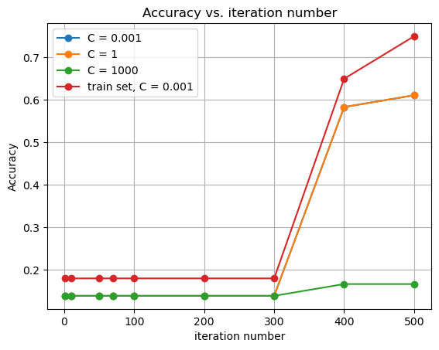
Neural Network-conclusion
ReLu, hidden_layer_sizes=(5, 2)

Slide 13
Conclusion
Current result:
Future improvements:
Larger and diverse datasets
More kernel use
Testing more combination of transformations and hyperparameters.
Linear Regression | SVM | Neural Network
R^2 = 0.374197 | 0.86 | 0.86

